Slide 1
Configuration of Server 2008
Prepared by: Eyerusalem Kebede
ID Number : RDCS 001/13
Submitted To: Zelalem
Submitted Date: Dec 16/2023

Slide 2
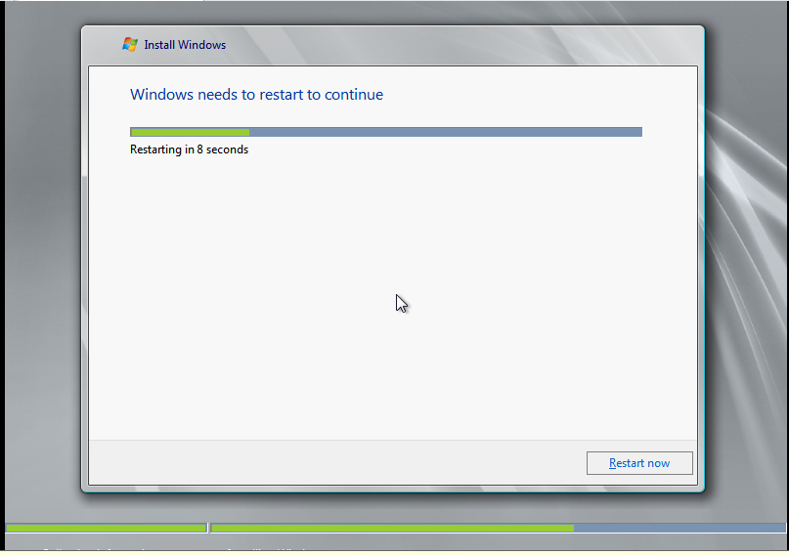
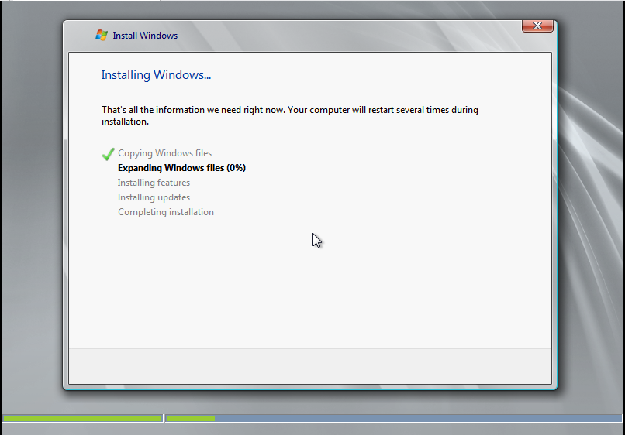
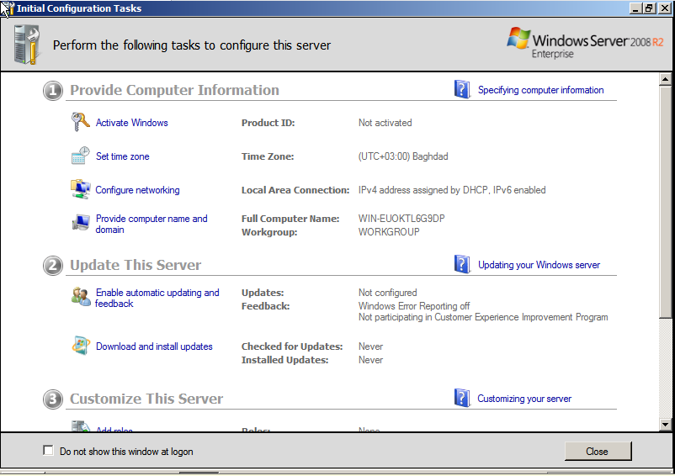
Server installation
Insert CD and press F12, then install follow the by the CD instruction

Slide 3
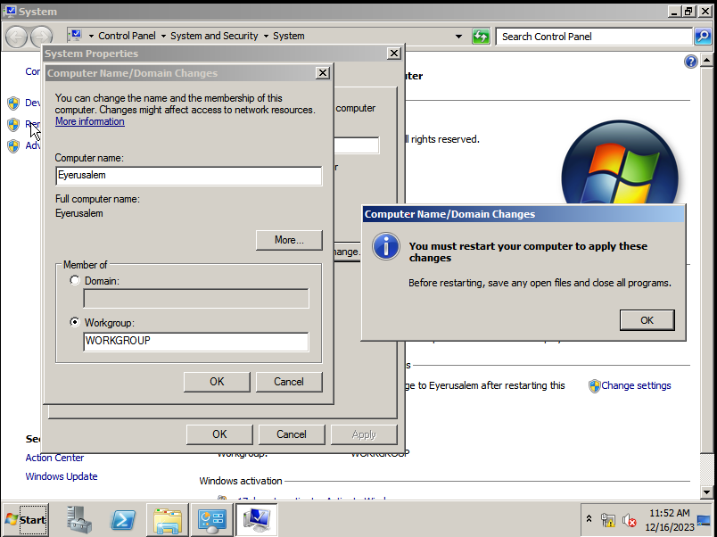
MODIFY COMPUTER NAME AND IP ADDRESS
Right Click on computer, Change Settings, Insert the name of computer, click OK then restart you’re the computer

Slide 4
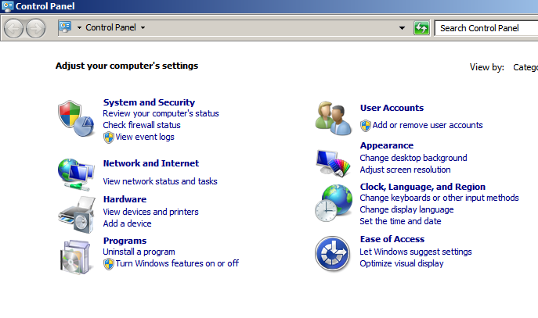
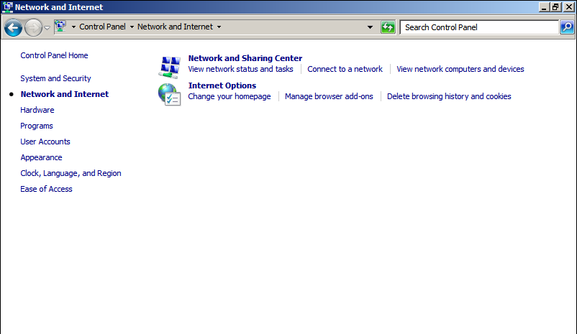
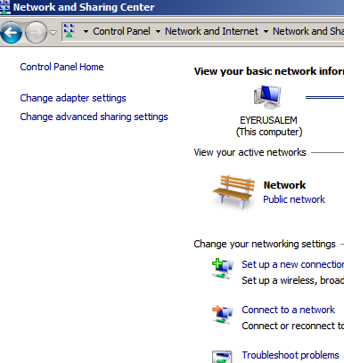
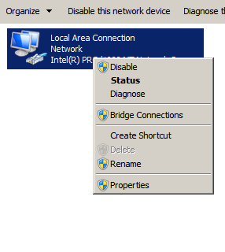
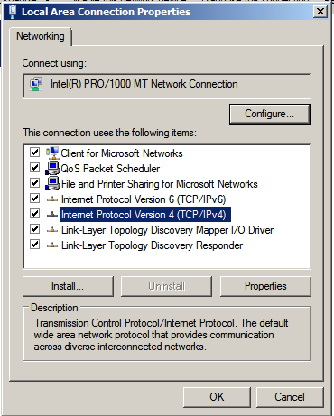
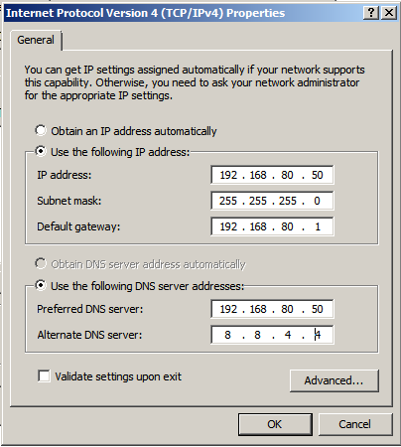
IP CONFIGURATION
Open control panel, Network and Internet, Network and Sharing Center, Change adapter settings
Right click on Local area network, click IPV4, properties, assign your IP address

Slide 5
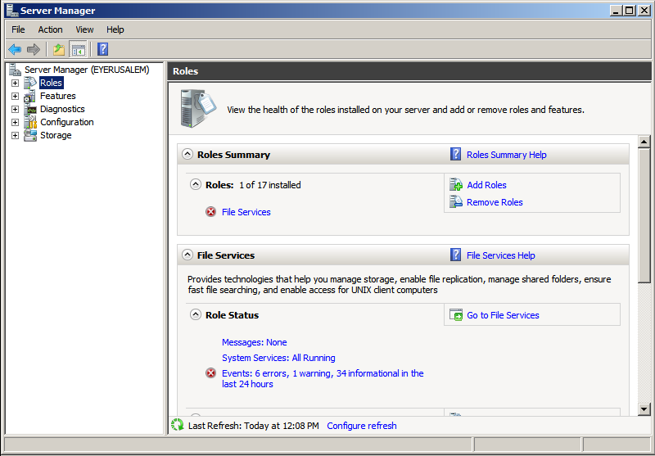
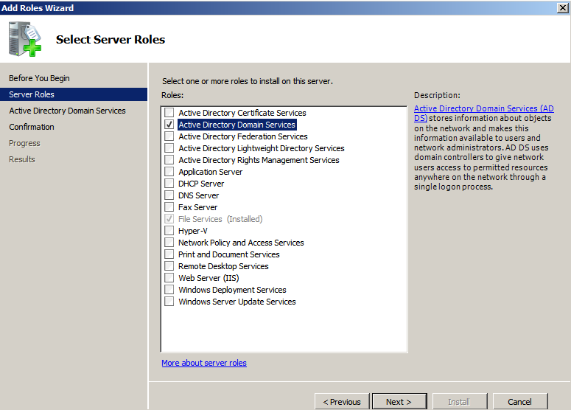
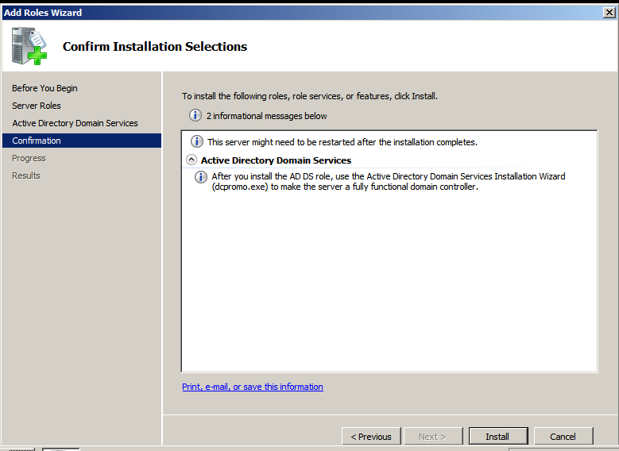
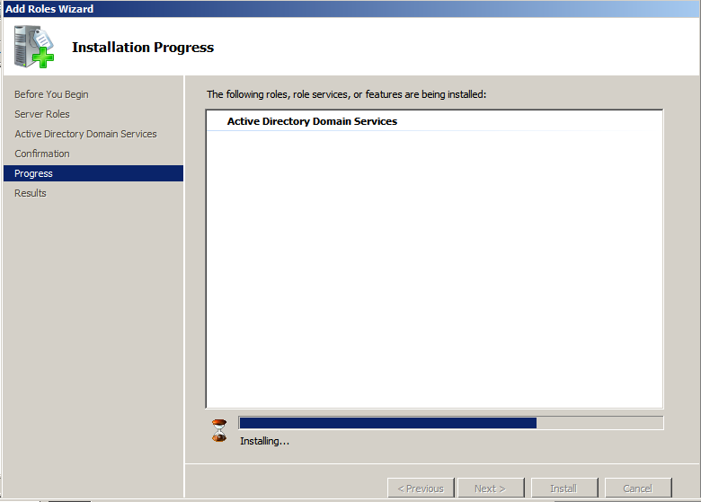
ADDS INSTALLATION
Open Server Manager, Expand Roles, Click Add Roles, Mark ADDS then click Next Install

Slide 6
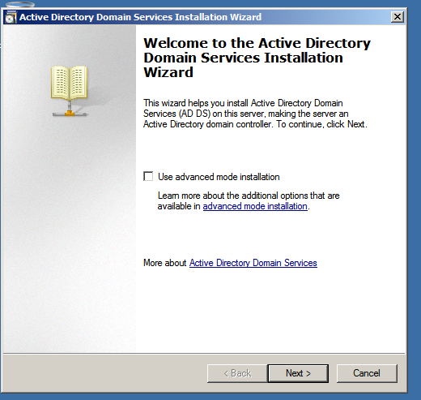
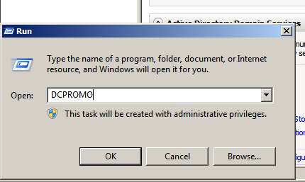
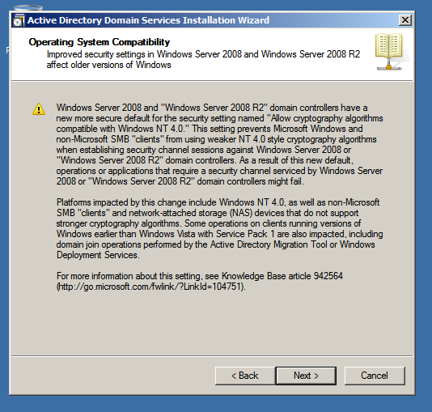
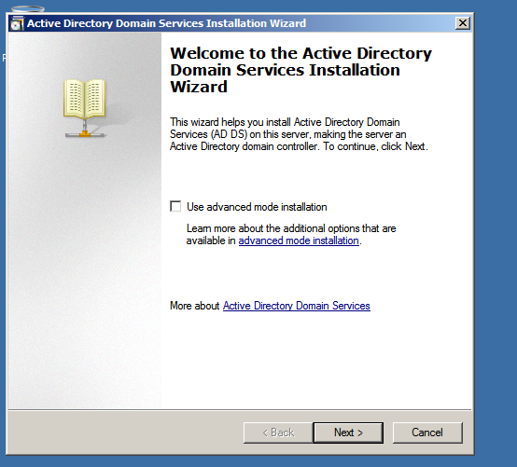
Click start search dcpromo

Slide 7
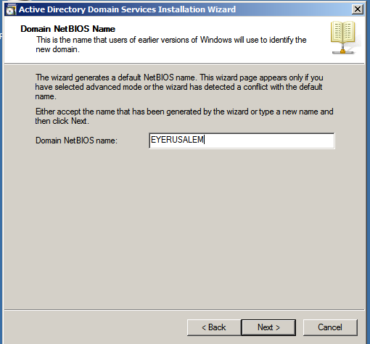
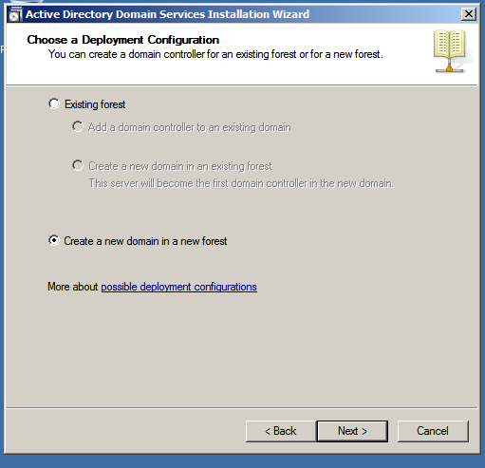
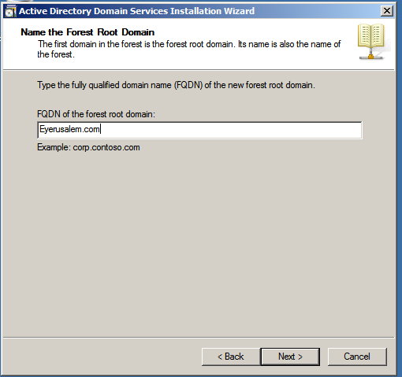
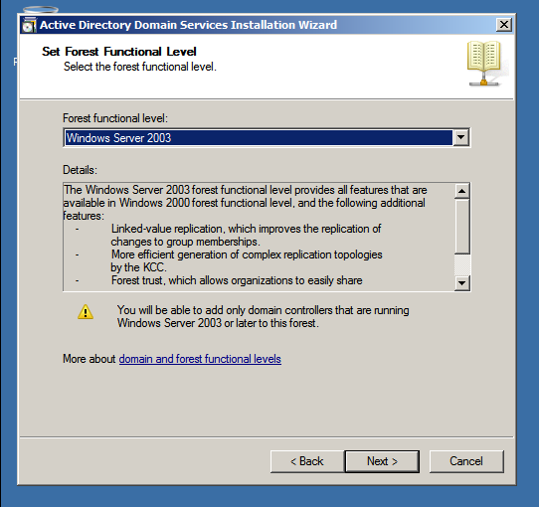
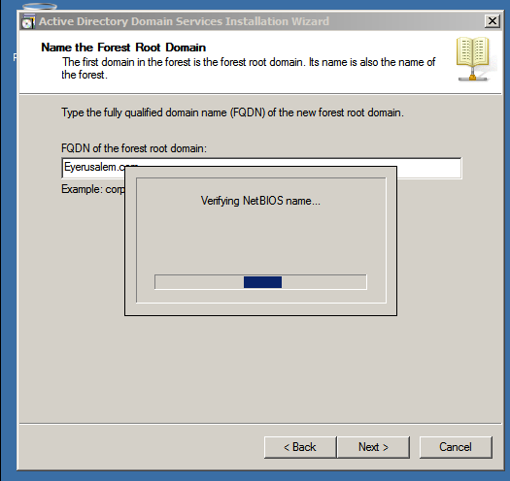
meet our team

Slide 8
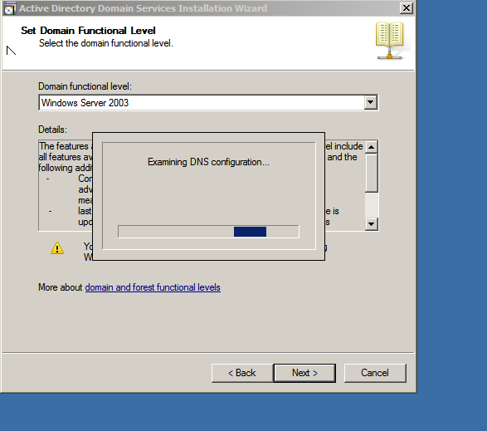
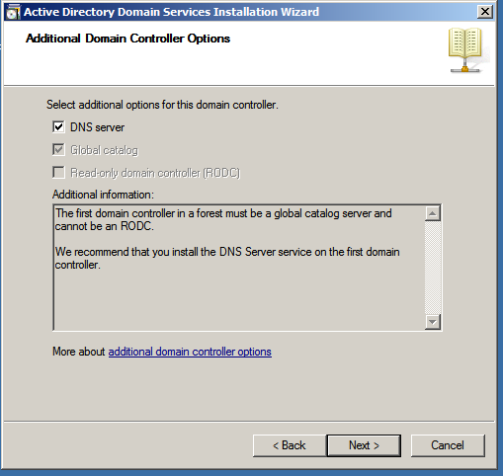
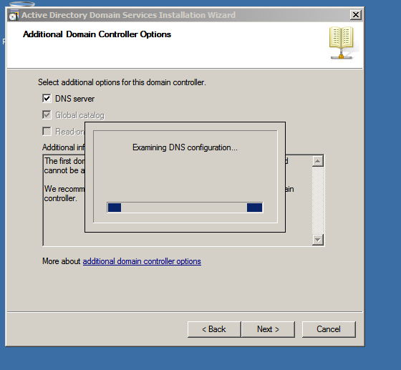
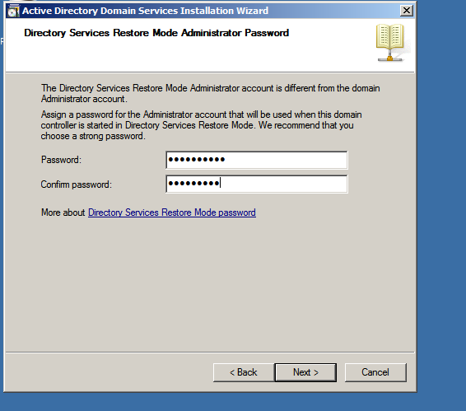
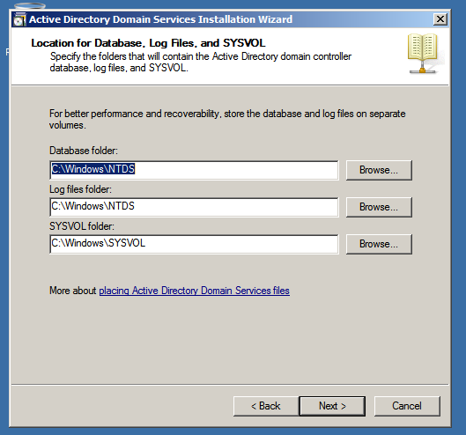
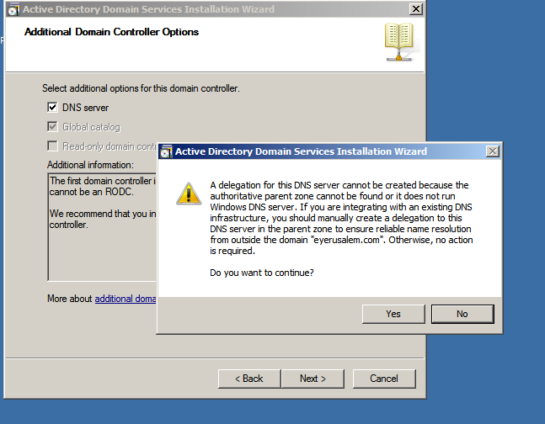
areas of focus

Slide 9
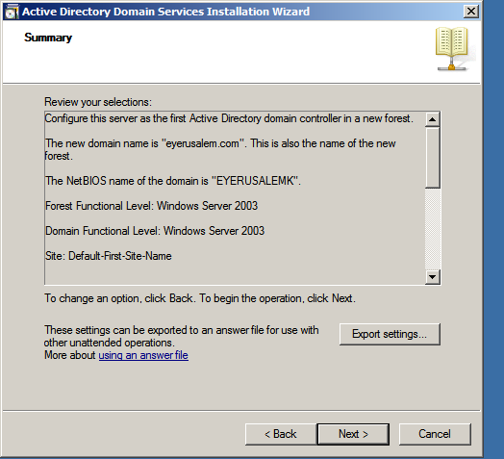
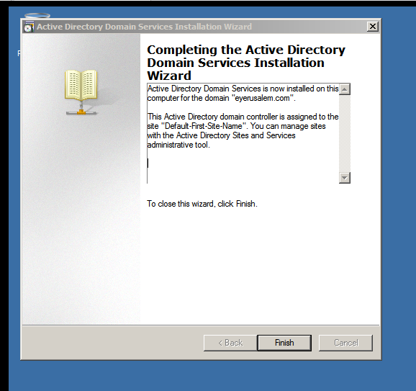
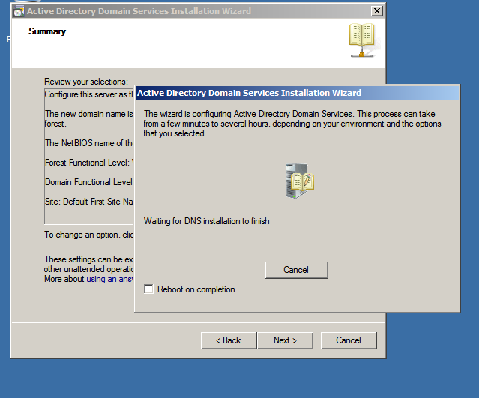
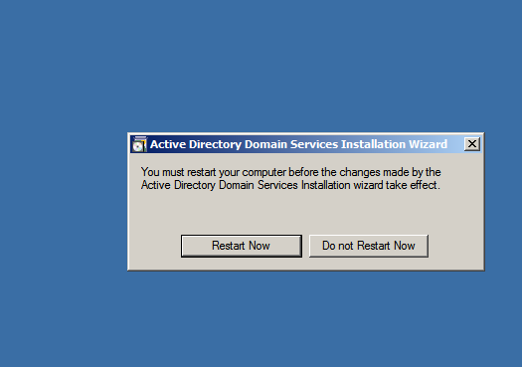
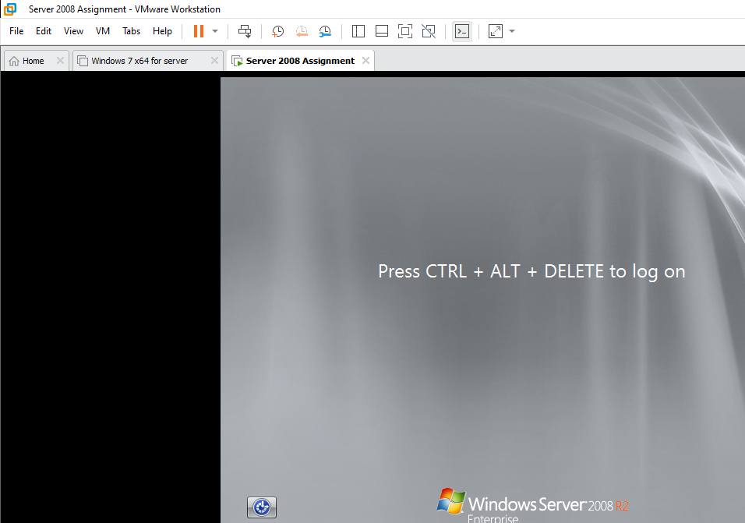
how we get there

Slide 10
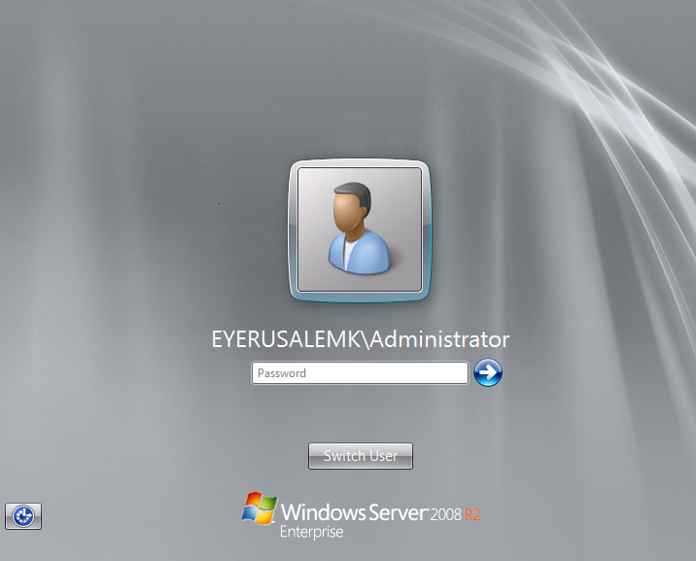
Install ADDS
After restart your account is automatically changed with ADDS name/username

Slide 11
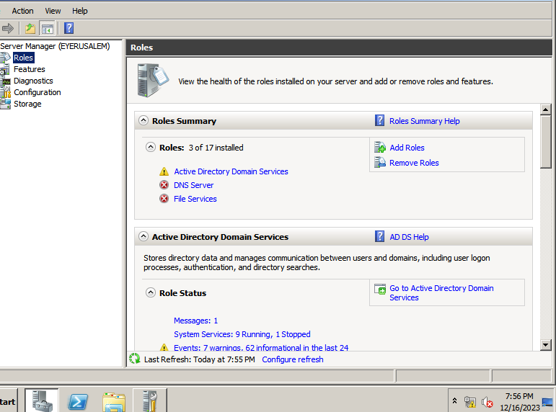
So, it’s show the DNS is installed or active

Slide 12
HOW TO INSTALL DYNAMIC HOST CONFIGURATION PROTOCOL (DHCP)

Slide 13
DHCP installation
Go to server manager Next step go to Add Roles

Slide 14
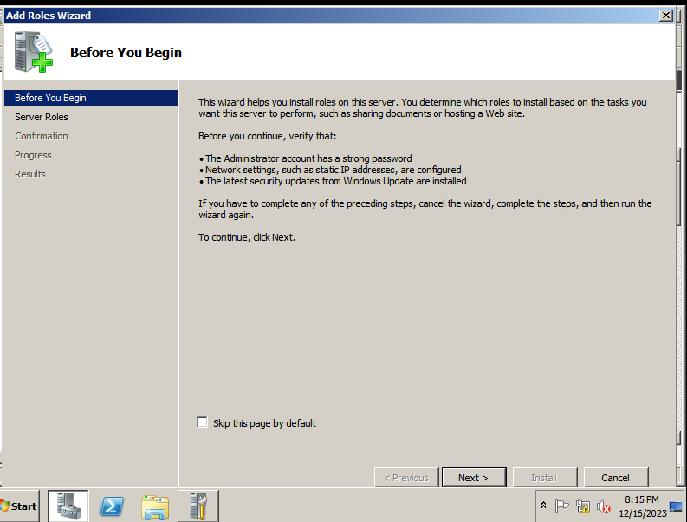
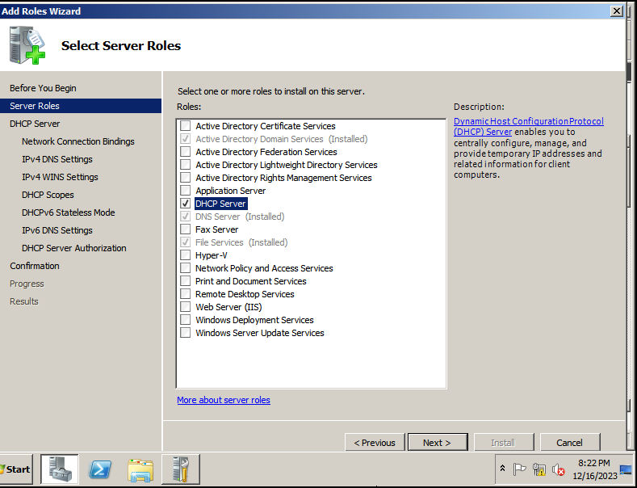
Click Next
Mark DHCP Server then click Next

Slide 15
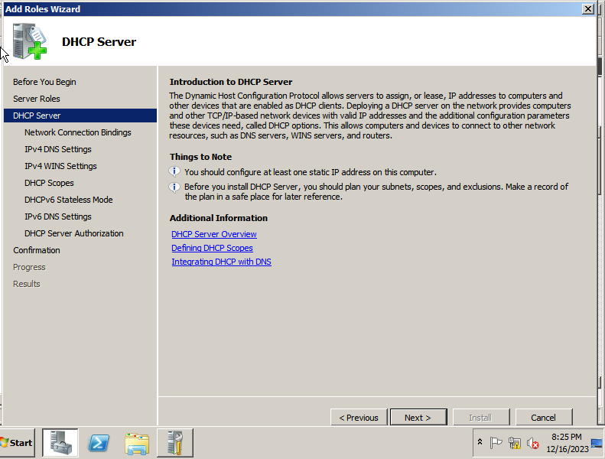
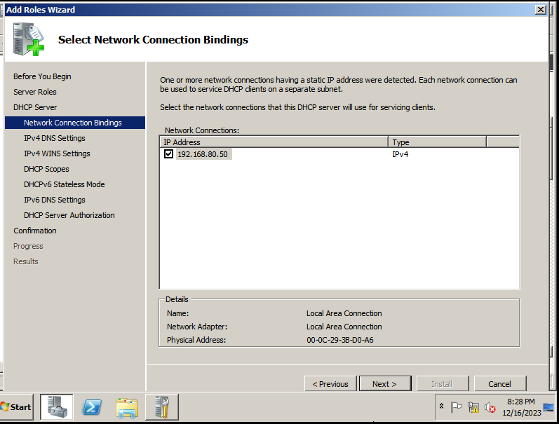
Click Next
Click Next

Slide 16
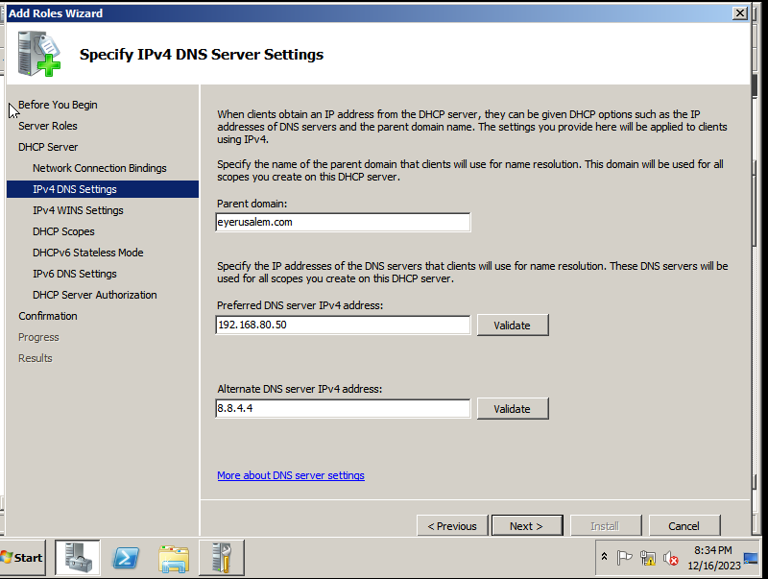
Installation DHCP
Click on preferred DNS server IPv4 address: validate button than Click Next And you date this valid message

Slide 17
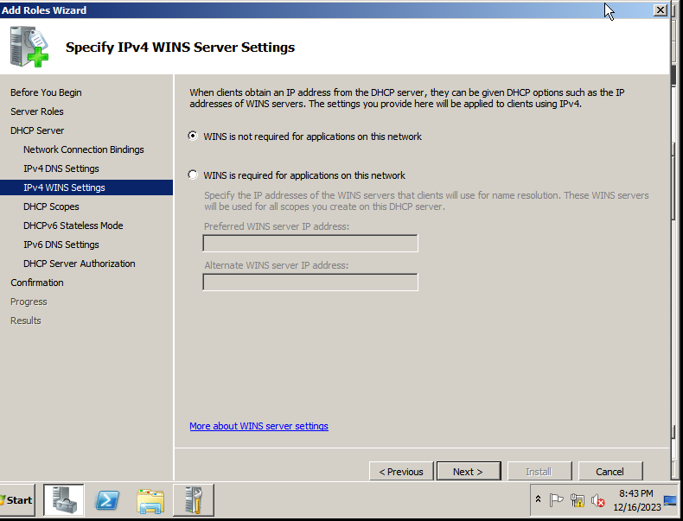
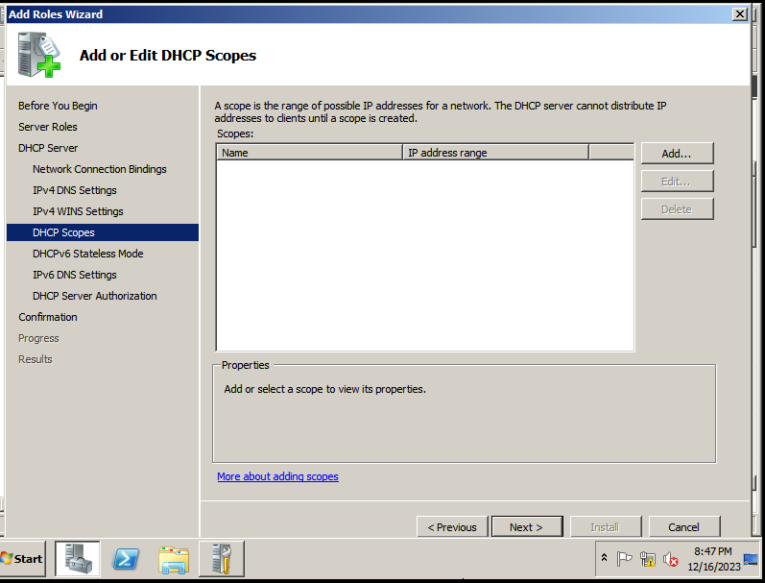
We are not use WINS setting so click Next
This step we add new DHCP scope

Slide 18
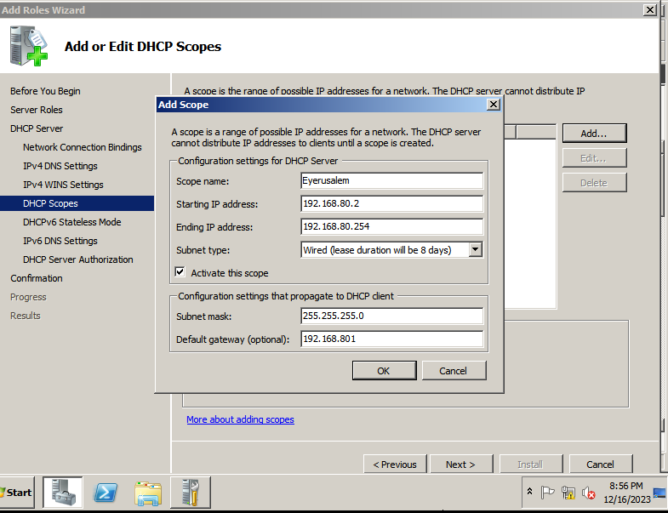
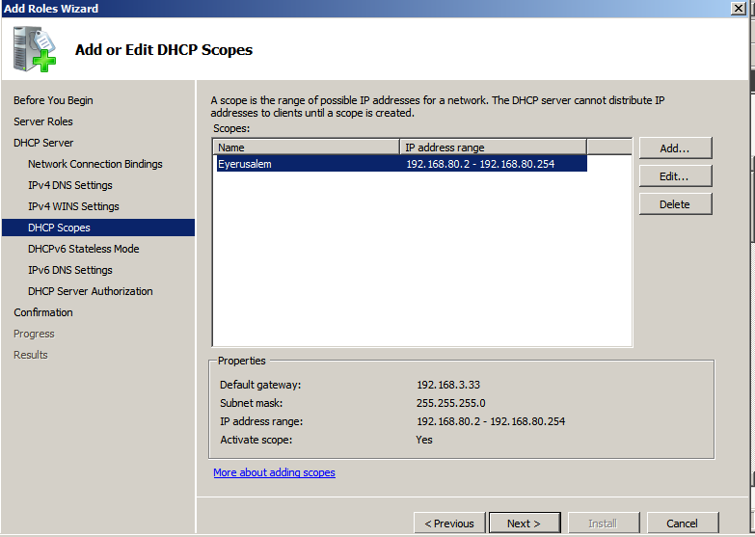
After click add button you get this form and insert carefully then click OK and Nex
Click Next

Slide 19
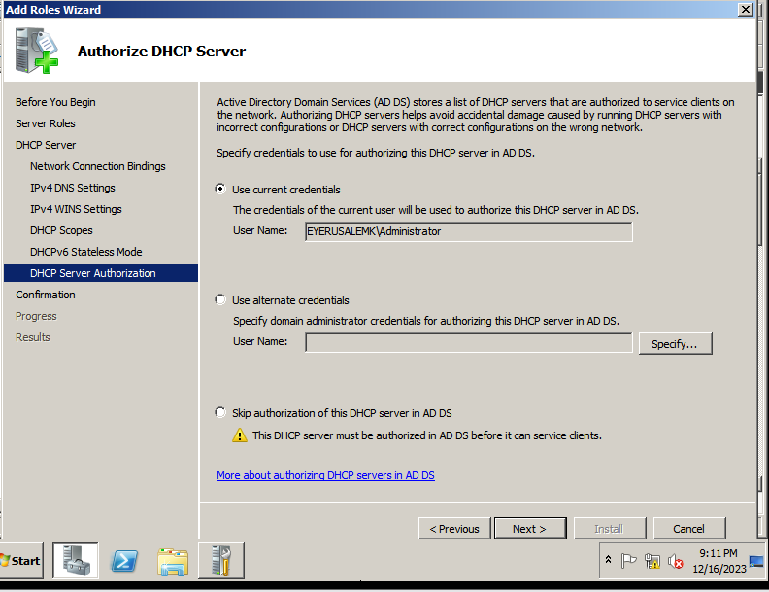
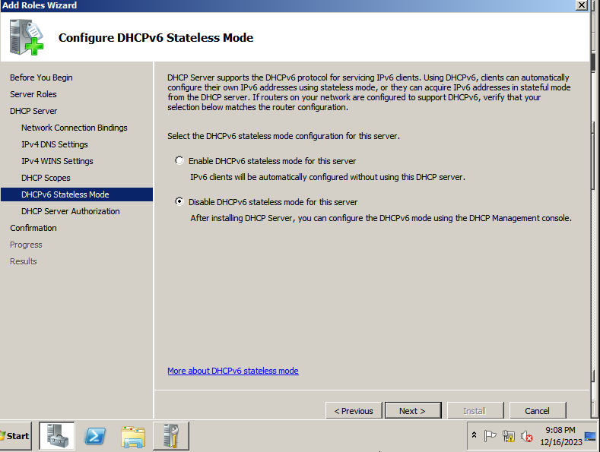
Disable DHCP IPv6 b/se we are not use it. And click Next
Select use current credentials, and click Next

Slide 20
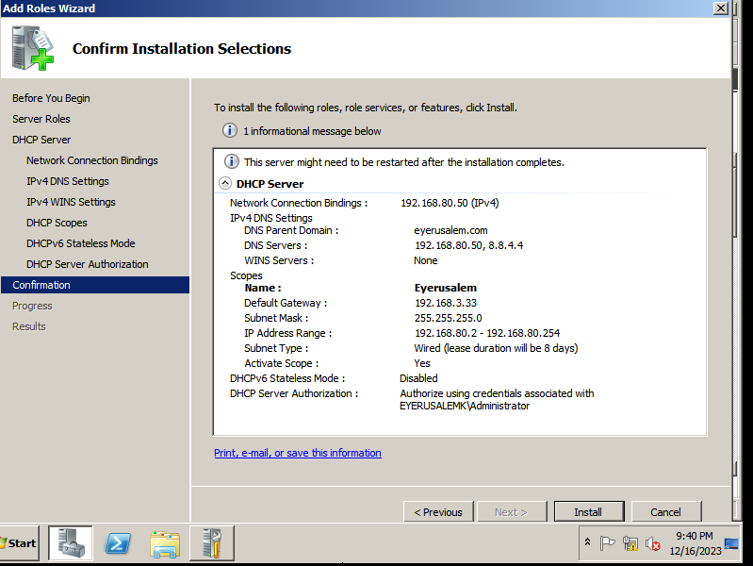
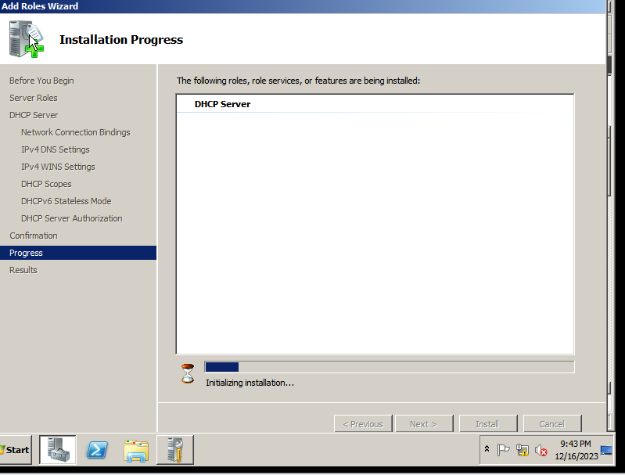
Check your configuration and click Install
The process of installation

Slide 21
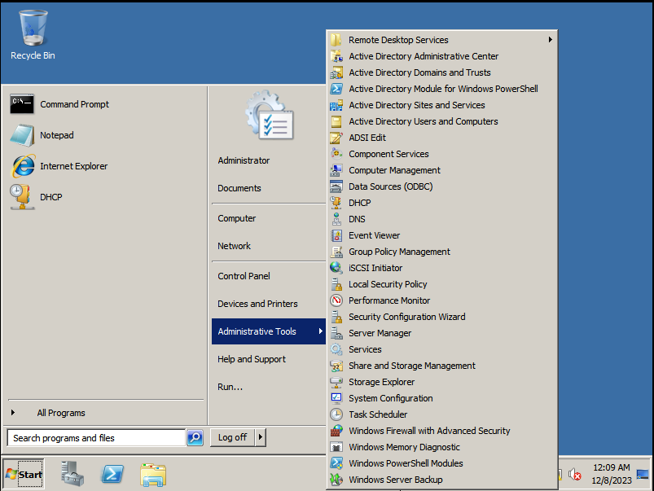

Click Start -> Administrative Tools -> DHCP -> Reservations Insert the IP Address and MAC Address

Slide 22

When it’s finished we get this information

Slide 23

Create structure like this

Slide 24

Start Administrative tolls than Active Directory user and Computers

Slide 25


Right click on domain name click new organizational unit insert name than click OK

Slide 26


Right click on your organizational Unit →click new →Group →Insert name →click OK

Slide 27



Click user icon and fulfill the information→ Next insert password→ click next then finished

Slide 28


Right click on created user and click properties Click Account then click Logon Hours
Logon Hour

Slide 29


First click Logon Denied Select Logon Time and click Logon Permitted then OK

Slide 30


Right click on created user and click properties Click Account then click Logon To. . .

Slide 31
JOIN CLIENT PC TO DOMAIN NAME

Slide 32


Change adapter settings Right click on Local Area Connection then property
Join to Domain

Slide 33


Click on Internet Protocol Version → click Properties Insert IP Address Preferred DNS server address then click OK

Slide 34


Start → Right click on Computer → Properties Change settings
Join to Domain

Slide 35


Click Change Click Domain and insert your domain name → OK It’s ask username and password of the domain → OK Finally it’s notice you joined the domain. Then click OK and restart your PC

Slide 36

When the PC is joined the domain always ask CTRL + ALT + DELETE to log on

Slide 37


We use username and password from server
First click on Switch User → Other insert username and password created on server then click the arrow → Then it’s give change password message

Slide 38


Insert your new password then get password has been changed message
JOINED

Slide 39
ASSIGN GROUP POLICY

Slide 40

Start → Administrative Tools → Group Policy Management

Slide 41


Assign Group Policy Complicity, Password length, and Expire
Expand Forest → Domains → Your domain name → Right click on your organizational unit Click Create a GPO

Slide 42


Change New GPO name → OK Right click on your new GPO and click Edit

Slide 43

Expand Computer Configuration → Polices →Windows Settings → Security Settings → Password Policy
Edit all passwords
settings

Slide 44


Double click on Password must meet complexity requirements
Mark Define the policy setting → click Disabled → Apply → OK
We get this box

Slide 45


Double click on Minimum password length Mark Define the policy setting → Insert character length→ Apply → OK

Slide 46


Double click on Minimum password length Mark Define the policy setting → Insert days → Apply → OK

Slide 47
FOLDER
SHARING

Slide 48


Sharing folder for specific group
Create new folder with HR → Right click on folder → Property Click Sharing → Share

Slide 49


Write group name → click Add Give permission in here and click Share

Slide 50



Done Advanced Sharing Apply → OK

Slide 51


Click on File Explorer → Network

Slide 53
REMOTE DESKTOP CONNECTION

Slide 54


Remote Desktop Connection
Start → Right click on Computer → Properties Remote settings → choose the 2nd → OK

Slide 55




Slide 56



Slide 57

Create new user from Remote Desktop

Slide 58



Slide 59




Slide 61
SERVER
BACKUP

Slide 62

Server Backup
Start → Features → Add Features

Slide 63


Mark Windows Server Backup Features → Next → Install

Slide 64


Process of Installation
Installation
Finished

Slide 65


Start → Administrative Tools → Windows Server Backup → Backup Once …

Slide 66


Next → Choose your backup configuration Full Server (recommended → Next

Slide 67


Choose Local drives → Next → Choose backup destination → Next

Slide 68


OK → Yes

Slide 69


Backup
Process

Slide 70


Close
You can check backup file in your choose storage drive

Slide 71
Thank you
Eyerusalem Kebede
eyerusalem_ke@yahoo.com

Slide 72





Slide 73






